Slide 1
Language Generation From Keywords
7th Semester Project
For
Artificial Intelligence Course
By-
Prateek Gupta -182
Shivendra Pratap Singh -191

Slide 2
Table of Contents
Introduction
Workflow
Data Preprocessing
Model Training
Model Testing
Results
Future Scope
References

Slide 3
Introduction
Natural Language Generation (NLG) is a technology that simply turns data into plain-English language. In other words, this means our software can look at your data and write a story from it, just like a human analyst would today.
The present work deals with generation of meaningful sentences from keywords that can be used for patients suffering from cerebral palsy.

Slide 4
Workflow
Data Preprocessing
Feature Selection and Extraction
Training Model
Testing Model Prediction Accuracy

Slide 5
Data Preprocessing
Data Preprocessing
Extracting unique words
Converting words to lower-case
Removing alphanumeric characters
Converting dataset into a dictionary wherein keys are the words used and values are the sentences with start(sos) and end(eos) tags attached

Slide 6
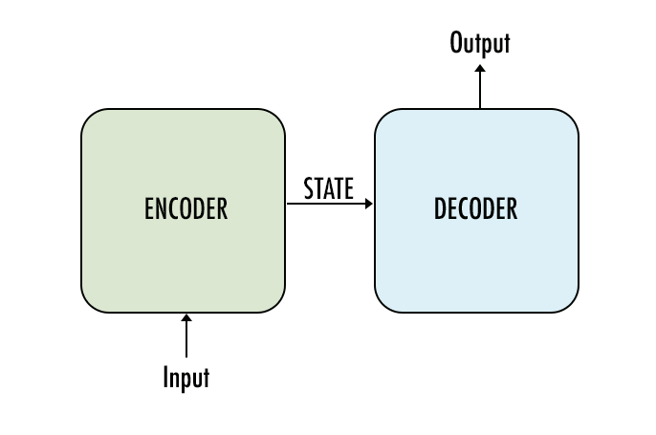
Model Training
The most common architecture used to build seq2seq models is the Encoder Decoder architecture. This is the one we will use for the current work.

Slide 7
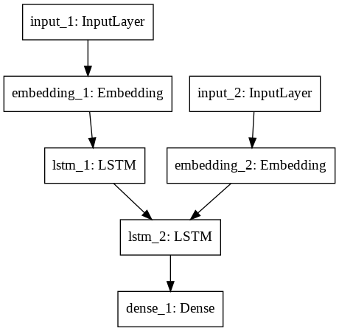
Encoder-Decoder

Slide 8
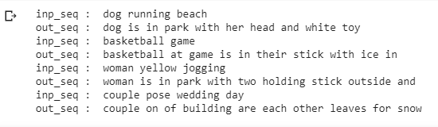
Model Testing and Inference
Input to Model
Output from Model

Slide 9
Future Scope
a. Get much more data. Top quality translators are trained on millions of sentence pairs.
b. Build more complex models like Attention.
c. Use dropout and other forms of regularization techniques to mitigate over-fitting.

Slide 10
References
https://towardsdatascience.com/word-level-english-to-marathi-neural-machine-translation-using-seq2seq-encoder-decoder-lstm-model-1a913f2dc4a7
https://blog.keras.io/a-ten-minute-introduction-to-sequence-to-sequence-learning-in-keras.html
https://towardsdatascience.com/understanding-feature-engineering-part-4-deep-learning-methods-for-text-data-96c44370bbfa

